Slide 1
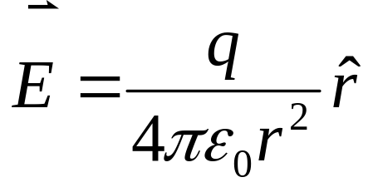
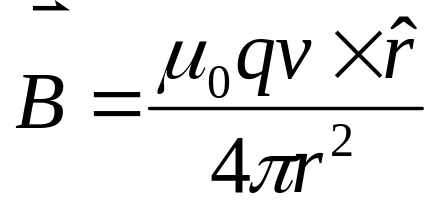
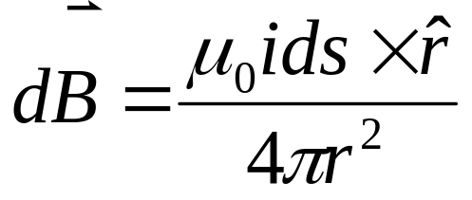
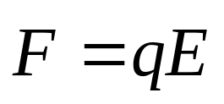
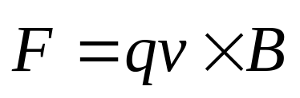
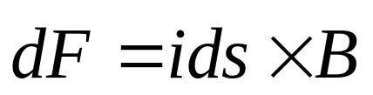
Electric Field
Magnetic Field

Slide 2
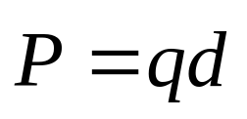
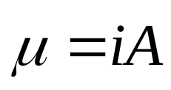
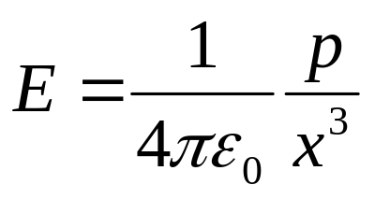
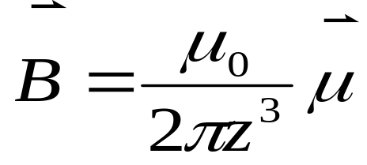
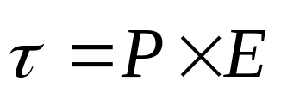
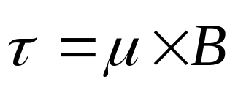
Electric Field
Magnetic Field

Slide 3
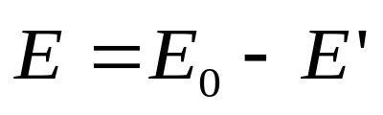
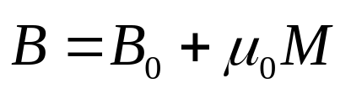
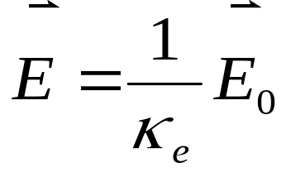
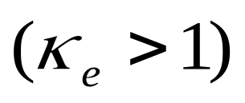
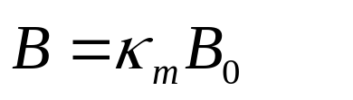
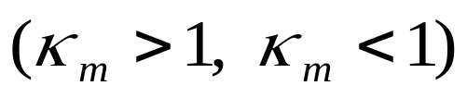
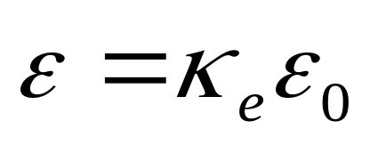
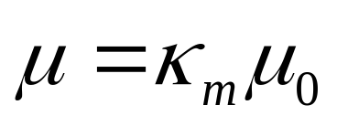
Electric Field
Magnetic Field

Slide 4
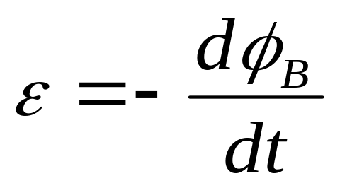
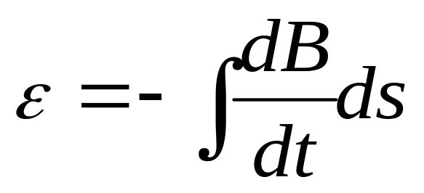
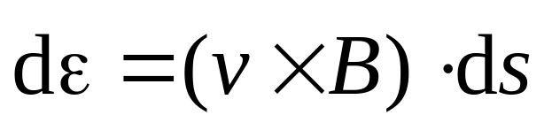
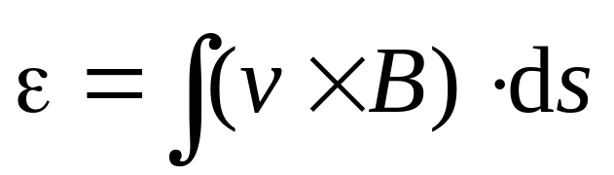
Induction

Slide 5
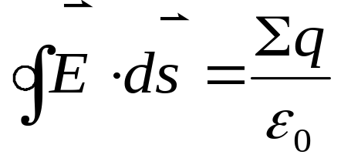
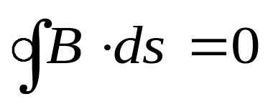
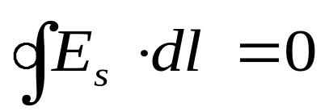
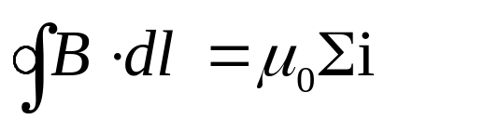
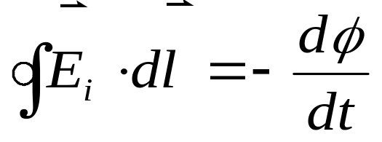
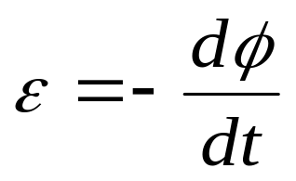
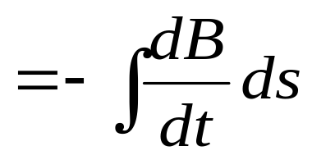
Electric Field
Magnetic Field

Slide 6
Chapter 36 Inductance

Slide 7

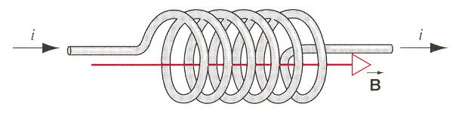
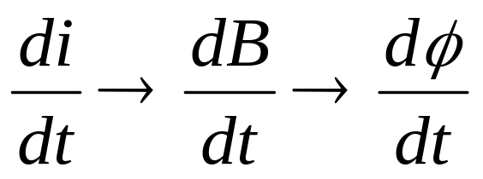



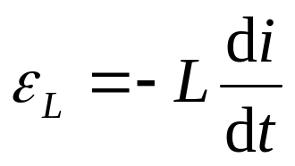


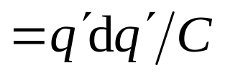
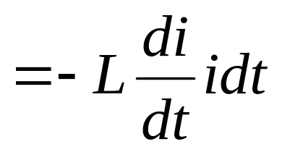

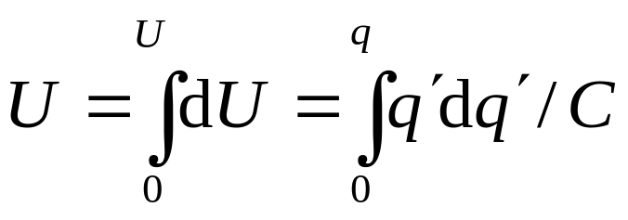
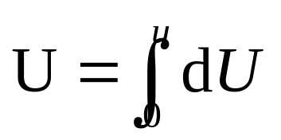
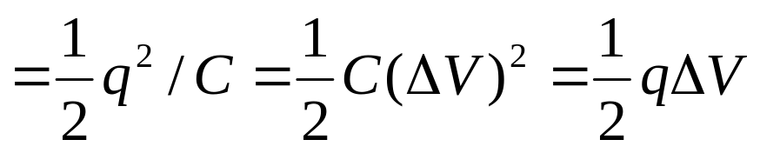
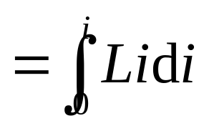
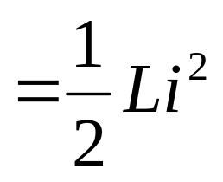
Capacitance
+
-
+
-
+
-
+
-
+
-
+
-
Inductance
Electric energy
Magnetic energy

Slide 8
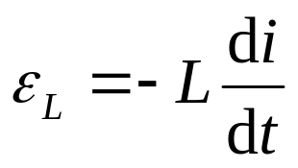
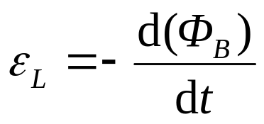
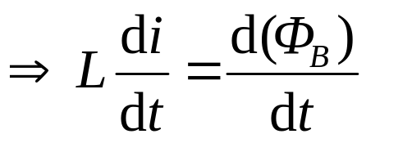
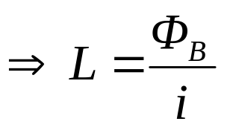



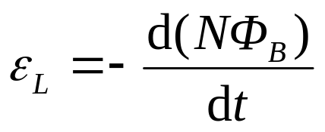
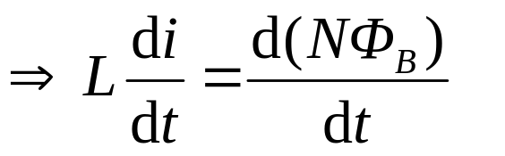
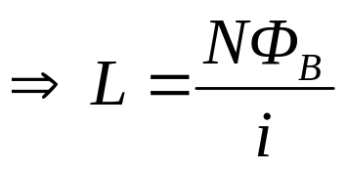

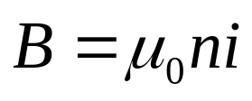
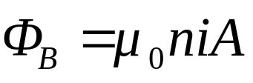



Calculating the Inductance
L is independent of i and depends only on the geometry of the device.

Slide 9











Inductance of a Toroid

Slide 10






Inductors with Magnetic Materials
Ferromagnetic cores (κ_{m} >>1, κ_{m} =10³ - 10⁴) provide the means to obtain large inductances.

Slide 11







RC Circuits
Combine Resistor and Capacitor in Series
a
  Switch at position (a)
Switch at position (b)
ε
b
R
C
LR Circuits

Slide 12










RC Circuits
Combine Resistor and Capacitor in Series
a
  Switch at position (a)
t→∞, i=ε/R.
ε
b
R
C
t=0, i=0
LR Circuits
ΔV_{R}=iR
inductive time constant
τ =L/R
ε_{ι}

Slide 13





RC Circuits
Combine Resistor and Capacitor in Series
a
  Switch at position (b)
t→∞, i=ε/R.
ε
b
R
C
τ =L/R
t=0, i=0
LR Circuits
ΔV_{R}=iR
ε_{ι}

Slide 14
















L-C circuit
Energy conservation
Energy conservation
Electric energy
Magnetic energy

Slide 15












Damped and Forced oscillations
If there are resistances in circuit, the U is no longer constant.
Resonance

Slide 16








Energy Storage in a Magnetic Field
ΔV_{R}=iR
εi= ε(dq/dt)= (εdq)/dt, the power by the emf device.
i²R, the power consuming in the resistor.
Li(di/dt), the rate at which energy is stored in the space of the inductor,
it can be put out, when switch to b

Slide 17









energy is stored in the electric field
i
inductance
U_{B}
energy is stored in the magnetic field
i
magnetic field
U_{B}

Slide 18










Analogy to Simple Harmonic Motion
1
1
U
=
kx
2
K
=
mv
2
s
2
2
1
q
2
1
U
=
U
=
Li
2
E
2
C
B
2

Slide 19
















Example
b
a

Slide 20
Exercises
P839-841 9, 10, 23, 41
Problems
P842 3, 5

